Slide 1
RoboTractor
Final Report
BeastMode
Arun Balaji Buduru
David Lucero
Jeremy Wright

Slide 2
Group Project Description
  The primary task of the RoboTractor project is to design a secure signaling and control system for the remote management of agricultural vehicles. Sub-tasks of this project are as follows:
    Use XMPP to provide communication between vehicle and server
      Simulate the vehicle with python
        Simulate a trusted hardware implementation on vehicle simulator
      Secure the XMPP communication with SSL/TLS and custom inter-stanza encryption
    Provide a secure interface using RESTful architecture
      Enhance security on user interface with two-factor authentication
    Create Front-End mapping interface including two-factor authentication to validate users for creating vehicle paths

Slide 3
Project Description (cont.)
Agriculture to reduce costs despite rising input costs (water, fertilizer, oversight documentation…)
REST and XMPP usage in agricultural vehicles allow the farmer to extend his machine capabilities over existing internet infrastructure enabling farmer optimize/reduce the operational cost.
Furthermore, these existing technologies can be securely implemented

Slide 4
Technical Details
RoboTractor operates on Virtual Machines provided by the ASU MobiCloud system (https://vlab.asu.edu) and amazon cloud systems
  These VMs are running Ubuntu 12.04 LTS
Django web framework for development server, web portal, and sqlite db
  Tastypie API framework for REST interfaces
Vehicle Simulators written in Python 2.x (as state machines)
XMPP servers and clients transmit encrypted JSON objects within stanzas
ejabberd and custom XMPP bridge module for communication between server and simulators
Google maps api for waypoint creation and path generation

Slide 5

Technical Details
Project setup (Network topology and requirements)
VM1
Server
VM2
Vehicle Simulators
sqlite
ejabberd
Each simulator is an individual python process
Django
Custom XMPP Bridge
Tastypie
(Development) Python Webserver
(Production) Apache Webserver

Slide 6
Technical Details
RoboTractor Roadmap and Milestones
Today
Project Demo
Tue 4/1/14 - Wed 4/2/14
Start
Mon 2/10/14
Feb 16, '14
Feb 23, '14
Mar 2, '14
Mar 9, '14
Mar 16, '14
Mar 23, '14
Mar 30, '14
Finish
Wed 4/2/14
REST Interface
Mon 2/24/14 - Fri 3/21/14
System Testing
Wed 3/26/14 - Tue 4/1/14
Server Backend
Wed 3/12/14 - Wed 3/19/14
Development Environment
Fri 2/21/14
Frontend UI
Mon 3/24/14
XMPP Implementation
Wed 3/26/14
REST Interface is functioning
UI design is Complete
Simulated Tractor is functioning
XMPP Backend is complete
UI integration with the google maps API is complete
UI integration with two factor authentication system is complete

Slide 7
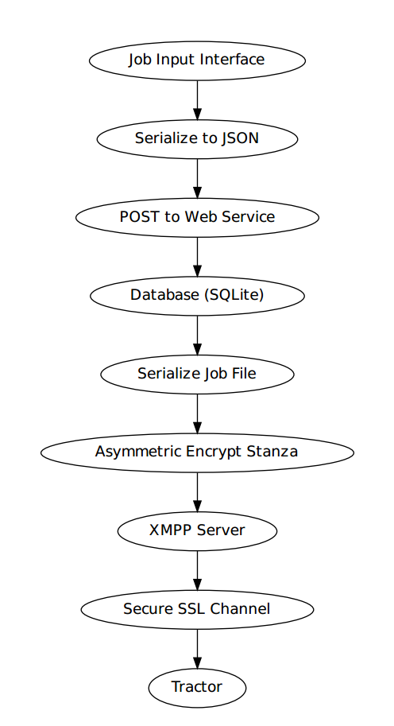
Technical Details
High Level Communication Path
  Initial Job is edited by the farmer on a website. Once the job is complete he can post the job to the tractor.
  The farmer is oblivious to the states here. He only know the tractor safely receives and executes the job.

Slide 8
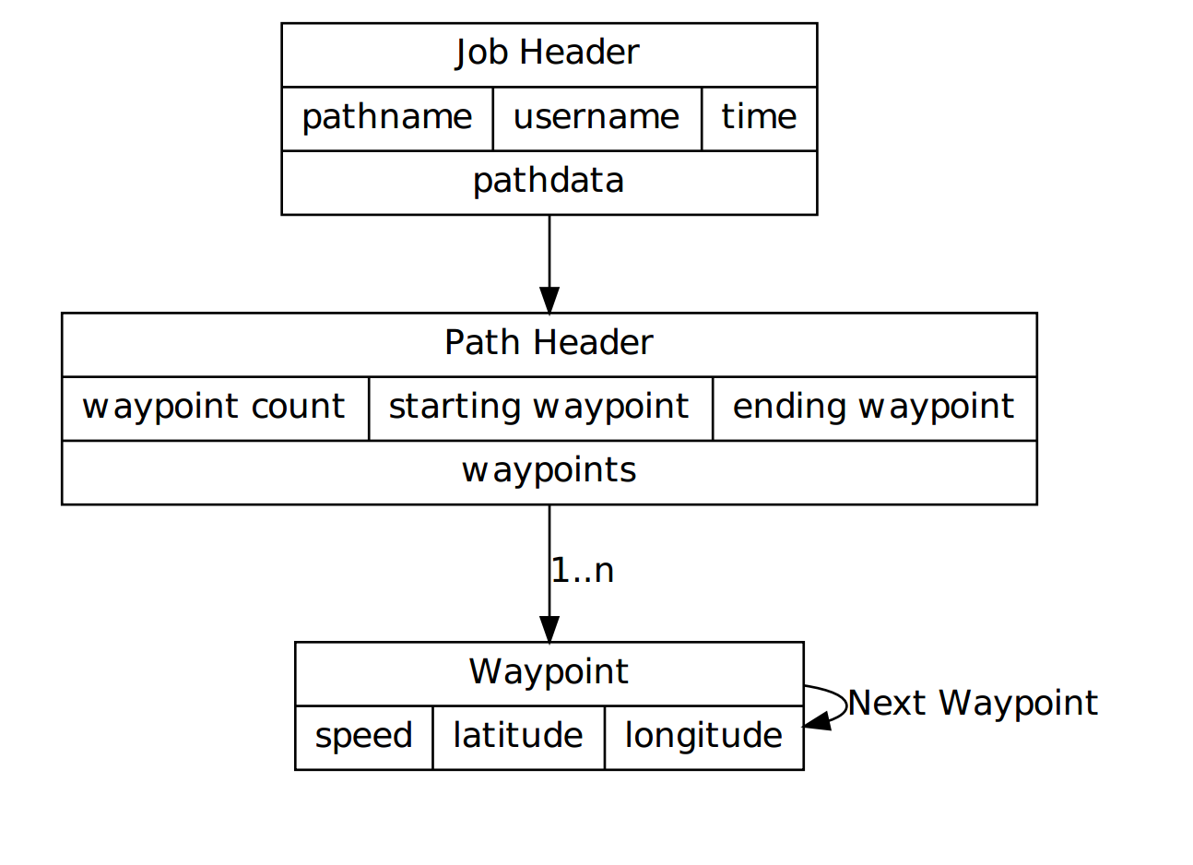
Technical Details
Tractors communicate to the server by sending encrypted “Job Files” in XMPP stanzas. The Job File is formatted as:

Slide 9
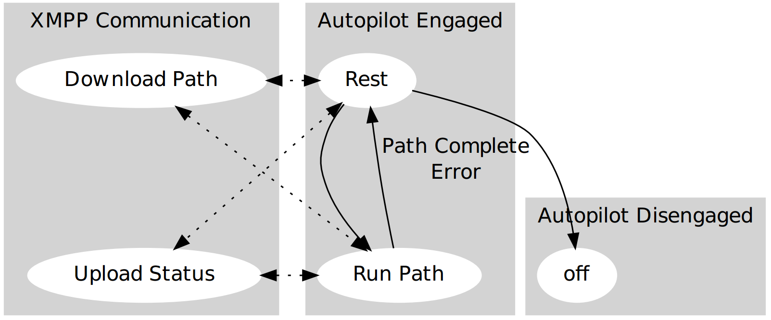
Technical Details
The tractor waits in this state machine for authenticated jobs.
Once a job arrives he executes the job, and returns to the rest state.

Slide 10
Risks and Benefits
Novel aspects of this project:
  Usage of Secure the XMPP communication with SSL/TLS coupled with custom inter-stanza encryption
  Usage of two factor authentication with XMPP and REST provides a secure method to utilize existing infrastructure for new agricultural needs.
Risks/challenges:
  Testing is currently behind schedule (described on next slide)
    Jeremy will transition to pick up more testing tasks to pick up the schedule gap
Potential applications & benefits:
  Bringing agriculture into the cloud can provide new market options in
    Agronomy
    Crop drying
    Crop futures trading
    Farm Automation

Slide 11
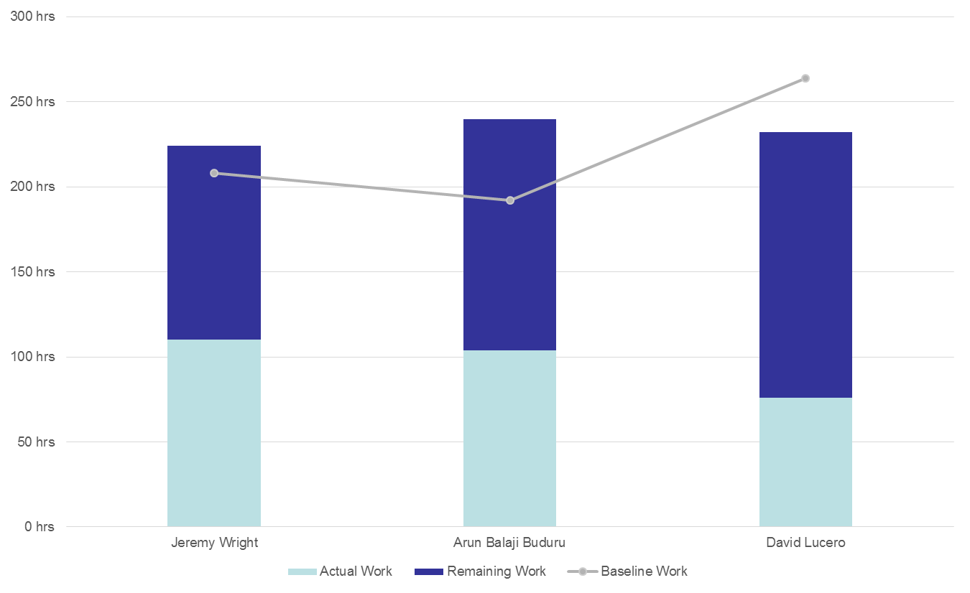
Schedule Risk

Slide 12
Tasks Accomplished by Now
Database Models
  Tractor
  Waypoint
  Job Format
Server Side Session Management
REST Interface (Session Based)
Two-Factor User Auth (Session Based)
Full scale Tractor Simulation
Front-end User Interface (Mapping & Waypointing)
Dual layer XMPP Stanza encryption

Slide 13
Tasks Accomplished by Now
Completed functioning REST interface (Jeremy)
Completed Front-end test interface (Arun)
Finalized design of Vehicle Simulator (David)
Completed API documentation for REST interface as external service (Jeremy, Arun, David)
Completed API documentation for XMPP interface of server to vehicle simulator channel (Jeremy, Arun, David)
Updated project schedule (Jeremy, Arun, David)
Updated report and presentation documents (Jeremy, Arun, David)
Integration of XMPP server with front end UI and tractor simulator

Slide 14
Conclusion
Corporate Farming is a growing market reality.
Agriculture has to continuously reduce costs to meet food costs and rising input costs (fertilizer, water, pesticides, etc).
Machine automation increases reproducibility, and reduces man hours.
REST and XMPP do this in a secure scalable manner.

Slide 15

Demo: Authentication

Slide 16
Demo: REST Query

Slide 17
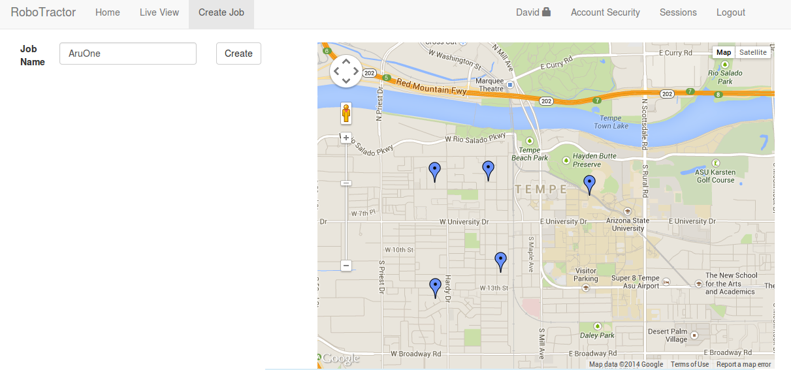
Visual: Front-End Create Job Interface

Slide 18
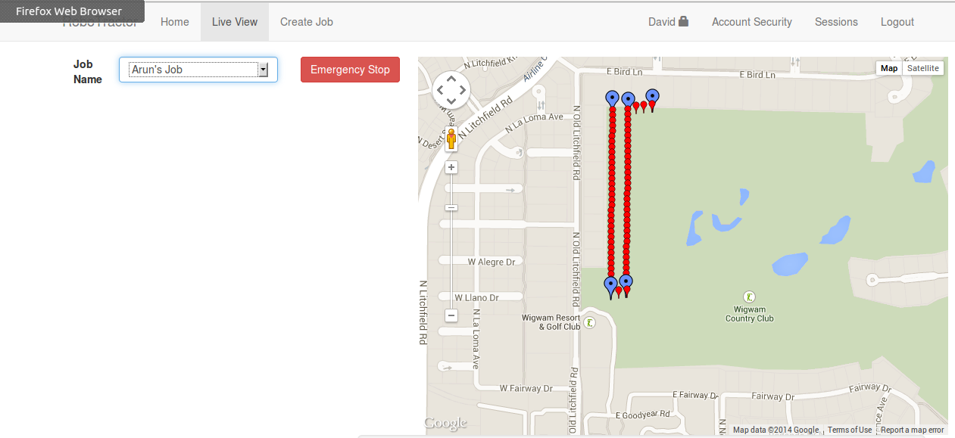
Visual: Front-End Live View Interface

